Slide 1
X-ray diffraction at extreme conditions: tools and practice
Signal from high pressure environment

Slide 2
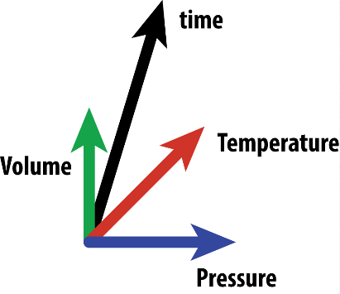
Classification of compression experiments
By volume
By compression rate
Small volume
Small volume
Static compression
DAC – dia. anvil cell
DAC – dia. anvil cell
Dynamic compression
Large volume
Based on static compression
Drickhamer press
Based on shock compression
Paris-Edinburgh press
Multi-anvil press

Slide 3
X-rays and interaction with matter
Scattering on electons
Absorption

Slide 4
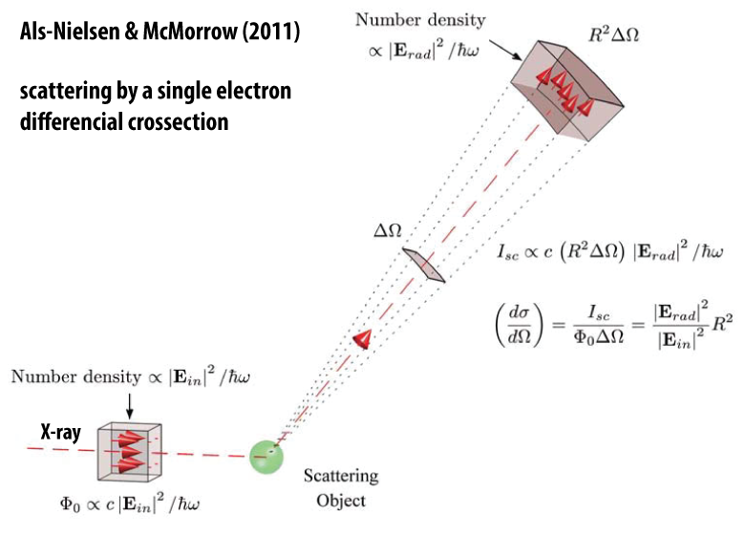
Thomson scattering – by an e⁻

Slide 5
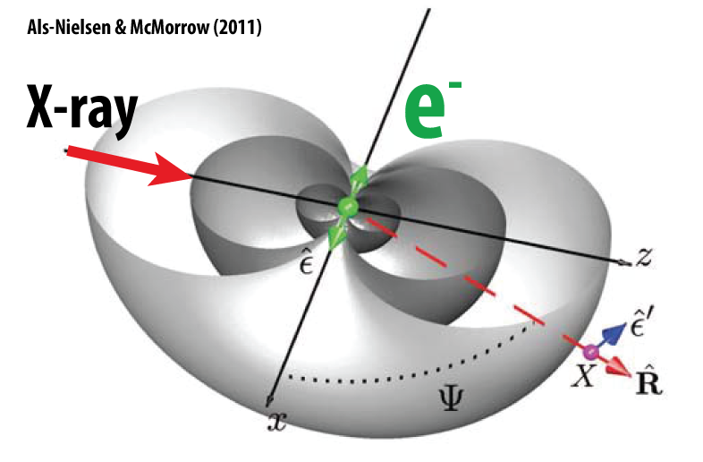
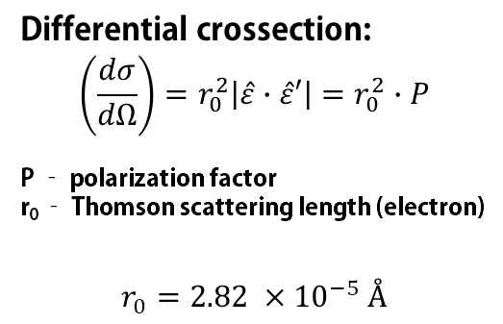
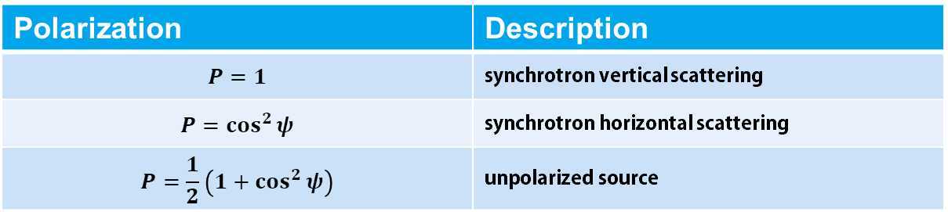
Thomson scattering – by an e⁻
Differential crossection:
$$\left(\frac{dσ}{dΩ}\right)=r_{0}^{2}\left|\hat{ε}∙\hat{ε}′\right|=r_{0}^{2}∙P$$
P – polarization factor
r₀ – Thomson scattering length (electron)
$$r_{0}=2.82 ×{10}^{−5} Å$$
Polarization | Description
$$P=1$$ | synchrotron vertical scattering
$$P=\cos^{2}{ψ}$$ | synchrotron horizontal scattering
$$P=\frac{1}{2}\left(1+\cos^{2}{ψ}\right)$$ | unpolarized source

Slide 6
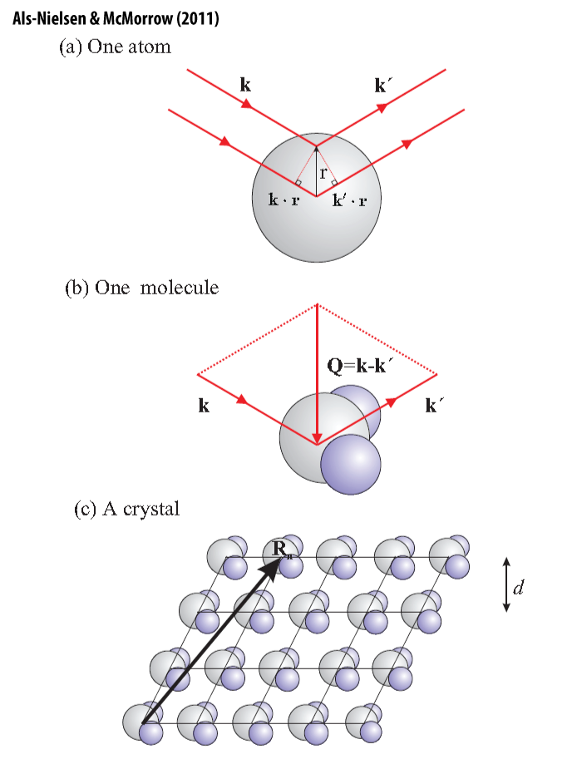
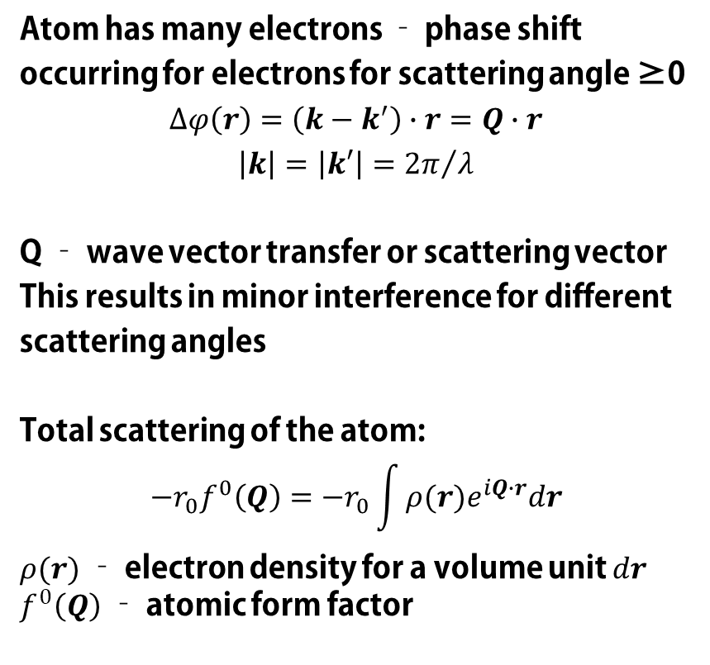
Growing in scale: atom
Atom has many electrons – phase shift occurring for electrons for scattering angle ≥0
$$∆φ\left(r\right)=\left(k−k^{′}\right)∙r=Q∙r$$
$$\left|k\right|=\left|k′\right|={2π}/λ$$
Q – wave vector transfer or scattering vector
This results in minor interference for different scattering angles
Total scattering of the atom:
$$−r_{0}f^{0}\left(Q\right)=−r_{0}\int{ρ(r)e^{iQ∙r}dr}$$
$ρ(r)$ – electron density for a volume unit $dr$
$f^{0}\left(Q\right)$ – atomic form factor

Slide 7
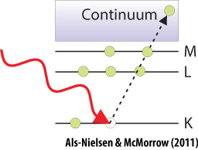
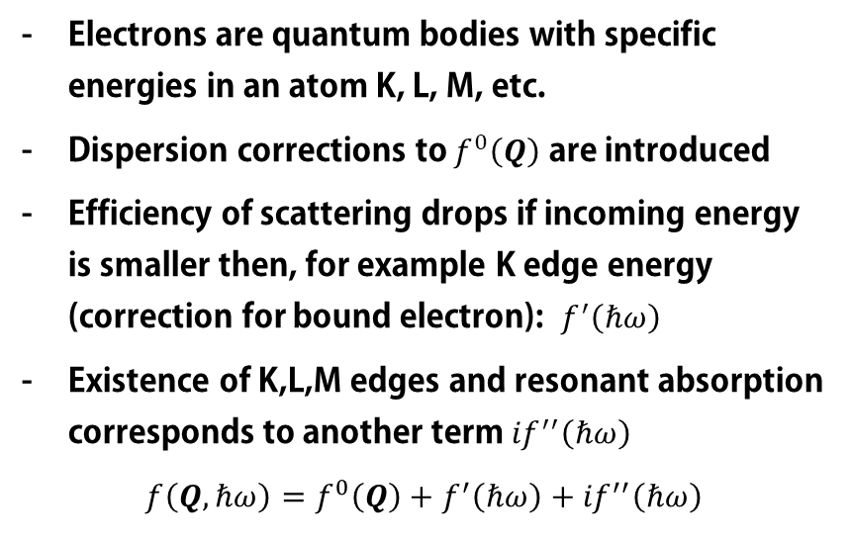
Growing in scale: atom
Electrons are quantum bodies with specific energies in an atom K, L, M, etc.
Dispersion corrections to $f^{0}\left(Q\right)$ are introduced
Efficiency of scattering drops if incoming energy is smaller then, for example K edge energy (correction for bound electron): $f^{′}\left(ℏω\right)$
Existence of K,L,M edges and resonant absorption corresponds to another term ${if}^{′′}\left(ℏω\right)$
$$f\left(Q,ℏω\right)=f^{0}\left(Q\right)+f^{′}\left(ℏω\right)+{if}^{′′}\left(ℏω\right)$$

Slide 8
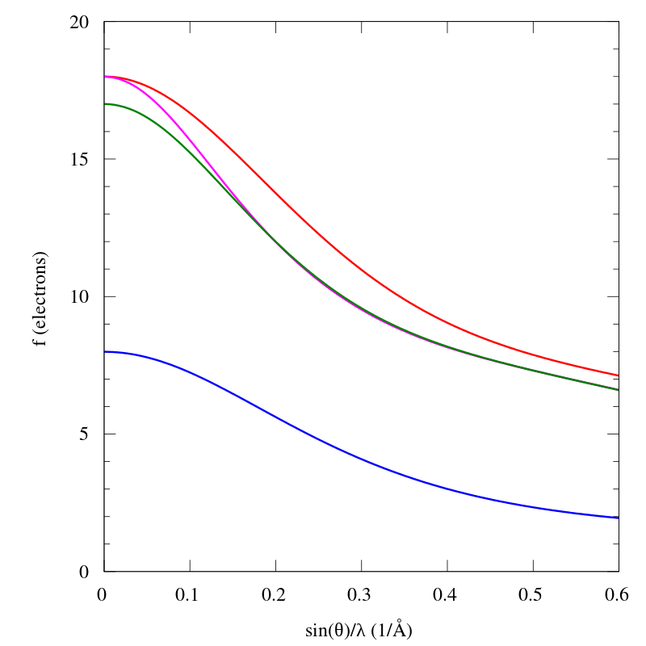
Growing in scale: atom
$$f\left(Q,ℏω\right)=f^{0}\left(Q\right)+f^{′}\left(ℏω\right)+{if}^{′′}\left(ℏω\right)$$
K⁺
Cl
Cl⁻
O
Wikipedia.org

Slide 9
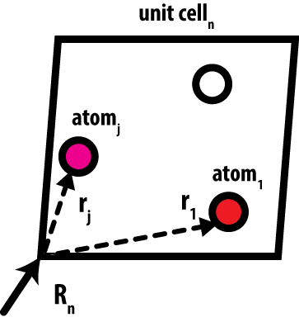
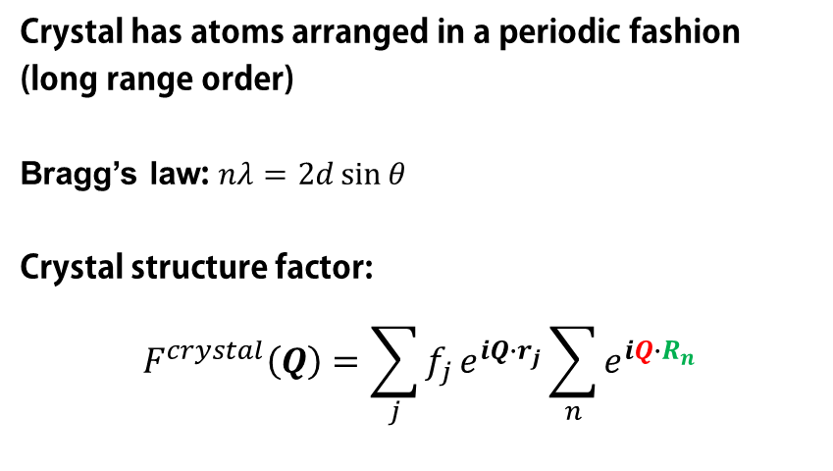
Growing in scale: crystal
Crystal has atoms arranged in a periodic fashion (long range order)
Bragg’s law: $nλ=2d\sin{θ}$
Crystal structure factor:
$$F^{crystal}\left(Q\right)=\sum_{j}{f_{j}}e^{iQ∙r_{j}}\sum_{n}{e^{iQ∙R_{n}}}$$
unit cell
structure
factor
lattice sum

Slide 10
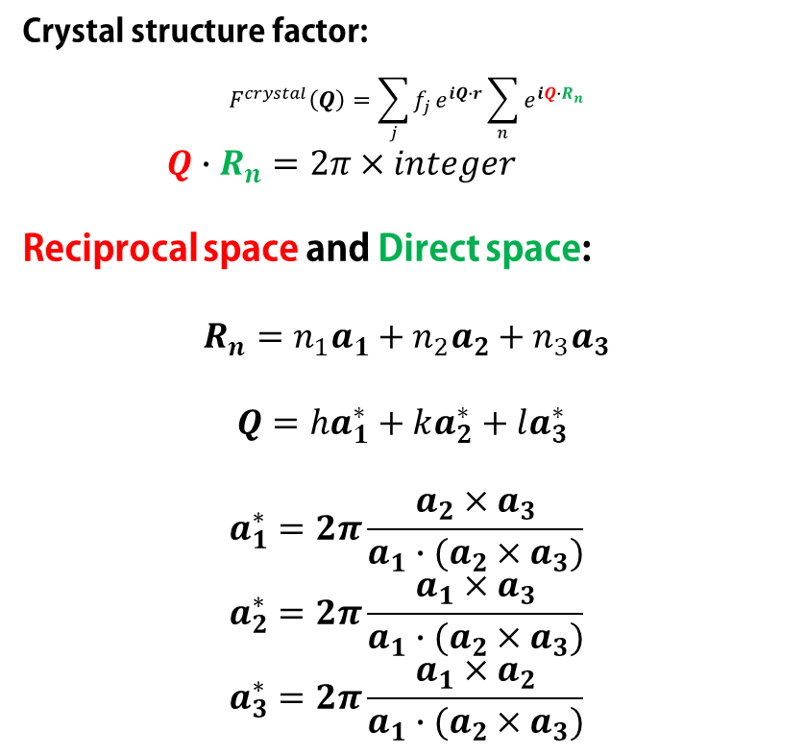
Growing in scale: crystal
Crystal structure factor:
$$F^{crystal}\left(Q\right)=\sum_{j}{f_{j}}e^{iQ∙r}\sum_{n}{e^{iQ∙R_{n}}}$$
$Q∙R_{n}=2π×integer$
Reciprocal space and Direct space:
$$R_{n}=n_{1}a_{1}+n_{2}a_{2}+n_{3}a_{3}$$
$Q=ha_{1}^{∗}+ka_{2}^{∗}+la_{3}^{∗}$
$$a_{1}^{∗}=2π\frac{a_{2}×a_{3}}{a_{1}∙(a_{2}×a_{3})}$$
$$a_{2}^{∗}=2π\frac{a_{1}×a_{3}}{a_{1}∙(a_{2}×a_{3})}$$
$$a_{3}^{∗}=2π\frac{a_{1}×a_{2}}{a_{1}∙(a_{2}×a_{3})}$$
Scattering from a crystal is therefore confined to distinct points in reciprocal space

Slide 11
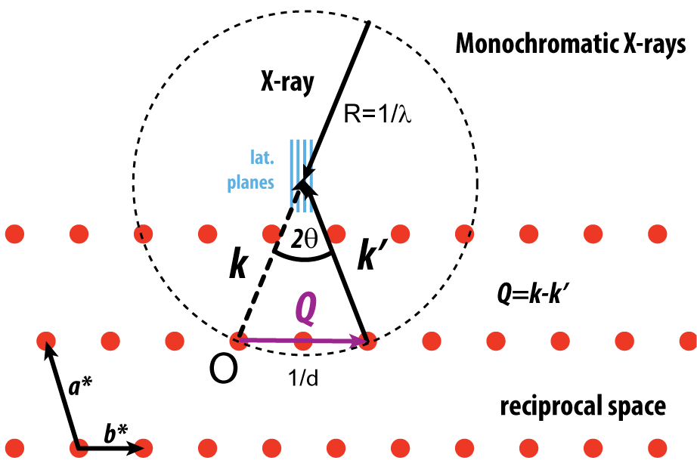
Growing in scale: crystal – monochromatic X-ray

Slide 12
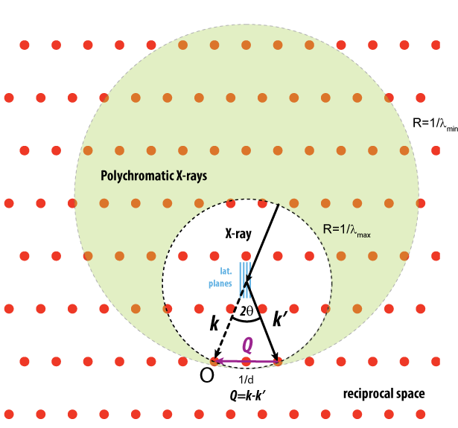
Growing in scale: crystal – polychromatic X-ray

Slide 13
Magnetic interactions
An X-ray photon can interact with electron.
Can this photon interact with its spin and orbital moment?
Short answer: yes, but.
Interactions with spin-orbit degrees of freedom are much weaker
Only small fraction of electrons have order in spin/orbital moments
Contribution to the intensity is 10⁻⁶ smaller
Challenging, but can be done for antiferromagnetic structures, at resonant energies (!!! – low energies)
Challenging, but can be done at high pressures (Ir, large Z)

Slide 14
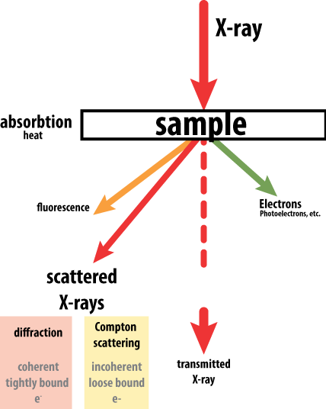
X-ray signal

Slide 15
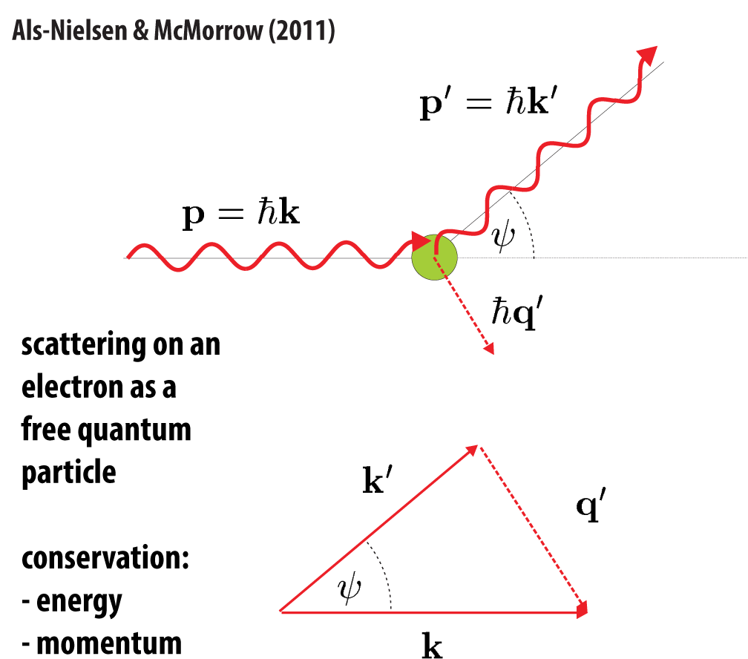
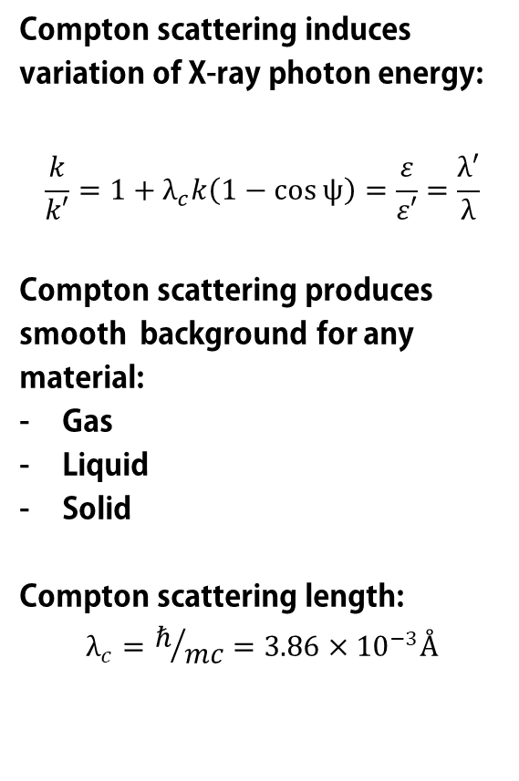
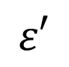
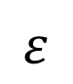
X-ray signal: Compton scattering
Compton scattering induces variation of X-ray photon energy:
$$\frac{k}{k′}=1+λ_{c}k\left(1−\cos{ψ}\right)=\frac{ε}{ε′}=\frac{λ′}{λ}$$
Compton scattering produces smooth background for any material:
Gas
Liquid
Solid
Compton scattering length:
$$λ_{c}=ℏ/{mc}=3.86×{10}^{−3}Å$$
$$ε′$$
$$ε$$

Slide 16
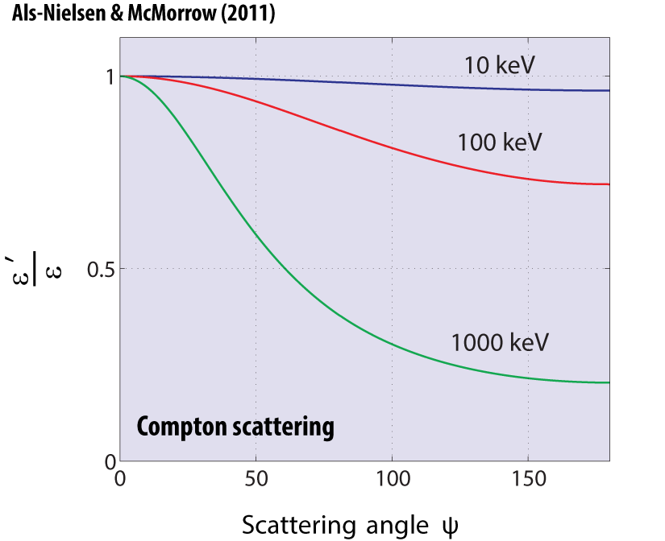
X-ray signal: Compton scattering
For XRD – background signal

Slide 17

X-ray signal

Slide 18
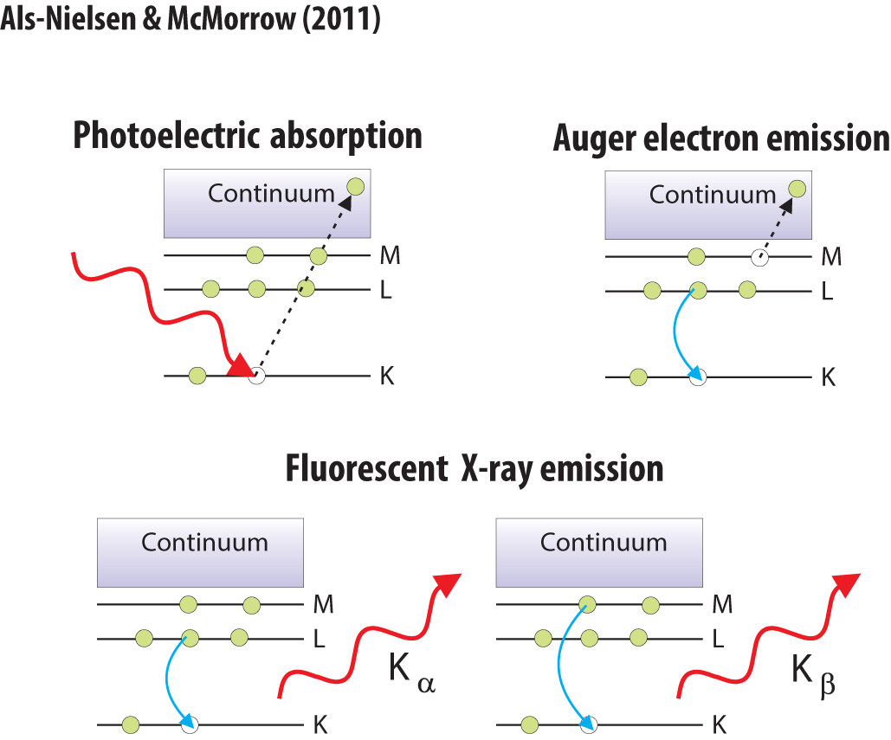
X-ray signal: photo electrons & fluorescence
XRD?
fine.
XRD?
Produces background

Slide 19
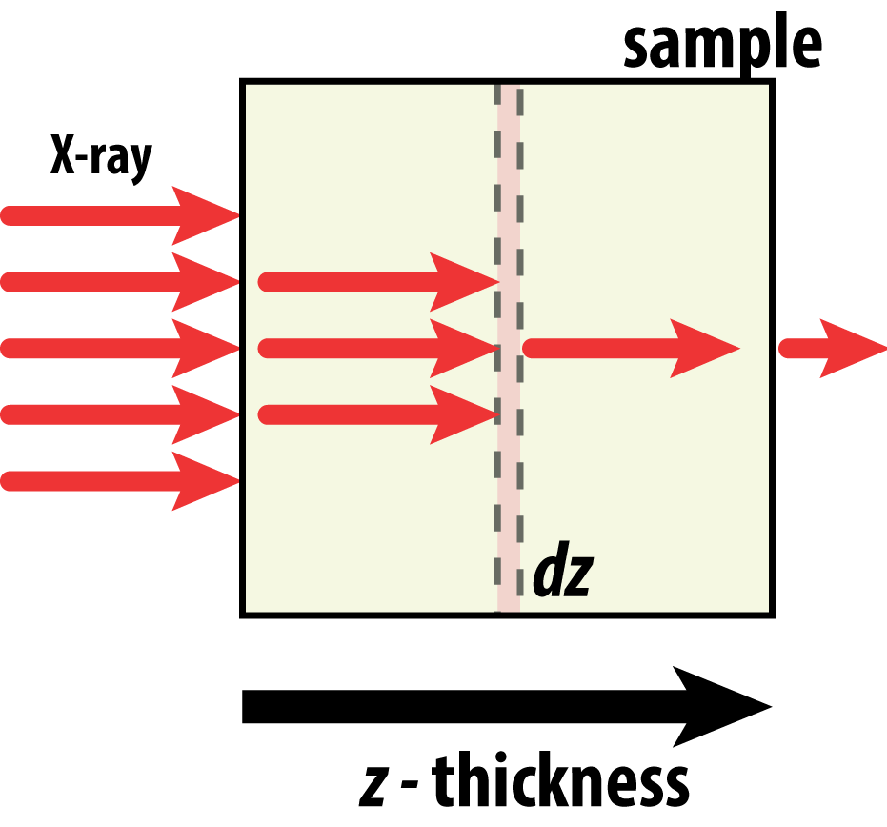
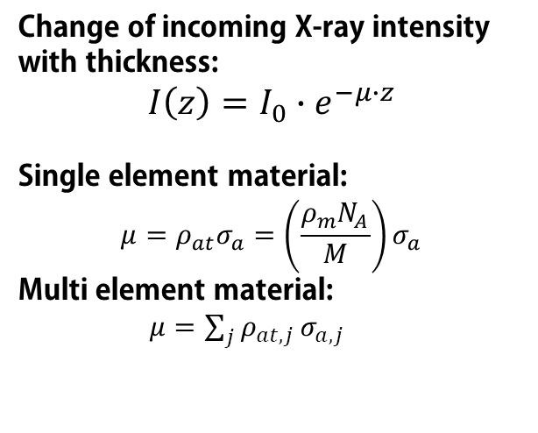
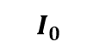

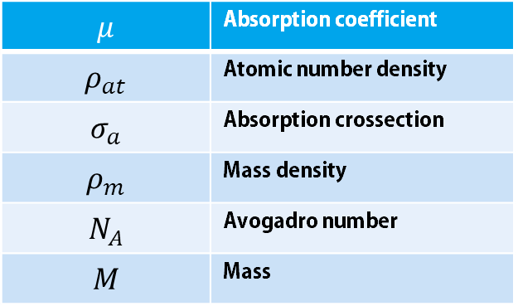
Absorption
Change of incoming X-ray intensity with thickness:
$$I\left(z\right)=I_{0}∙e^{−μ∙z}$$
Single element material:
$$μ=ρ_{at}σ_{a}=\left(\frac{ρ_{m}N_{A}}{M}\right)σ_{a}$$
Multi element material:
$μ=\sum_{j}{ρ_{at, j}}σ_{a, j}$
$$I\left(z\right)$$
$$I_{0}$$
$$μ$$ | Absorption coefficient
$$ρ_{at}$$ | Atomic number density
$$σ_{a}$$ | Absorption crossection
$$ρ_{m}$$ | Mass density
$$N_{A}$$ | Avogadro number
$$M$$ | Mass

Slide 20
X-ray diffraction and HP environments
Environment affects
Scattering (adds to incoherent; background Compton)
Scattering (adds to coherent; additional peaks)
Fluorescence yield (background; lower signal/noise)
Absorption (lowers amount of X-rays on your sample)
Absorption (absorbs signal from the sample; lower signal/noise)

Slide 21
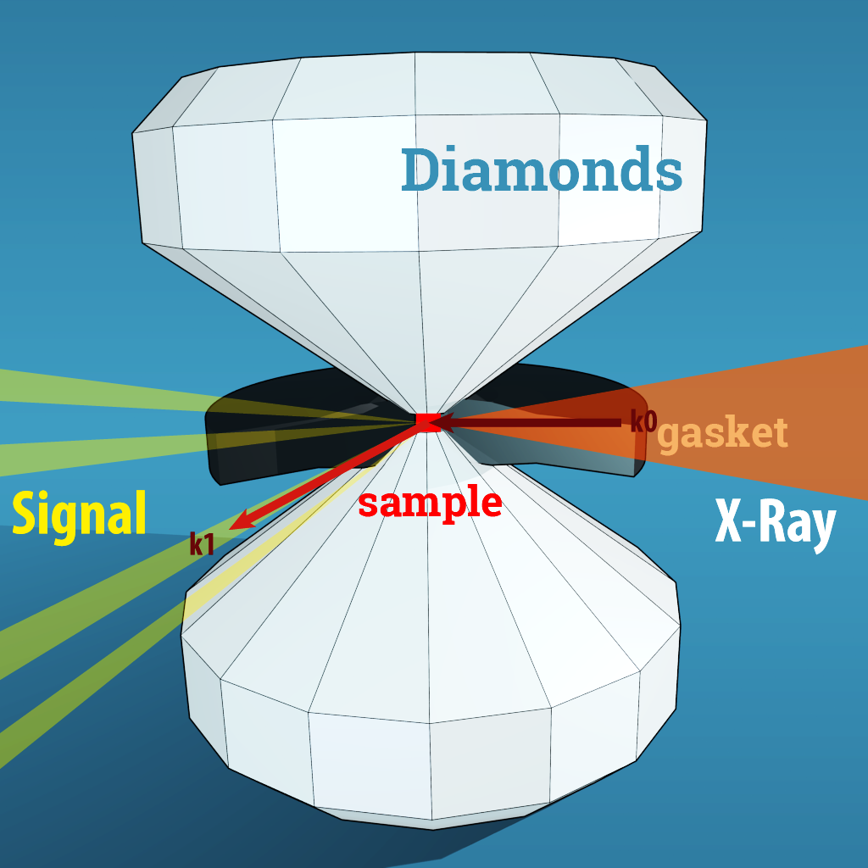
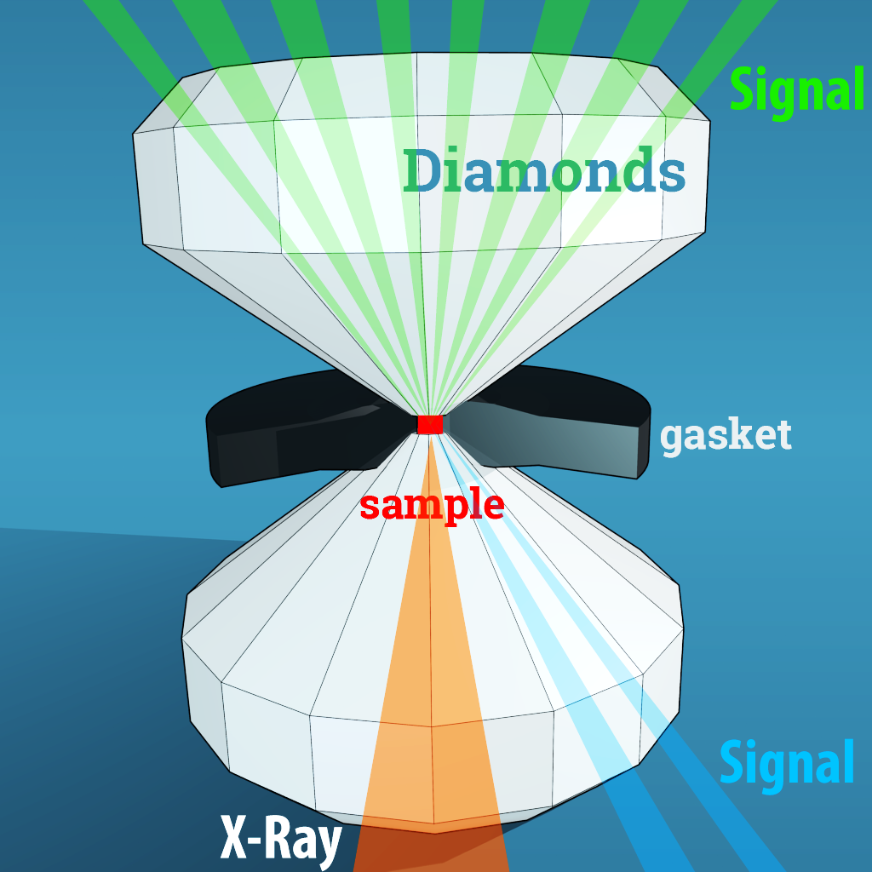
X-ray diffraction and HP environments
Environment is a complication

Slide 22
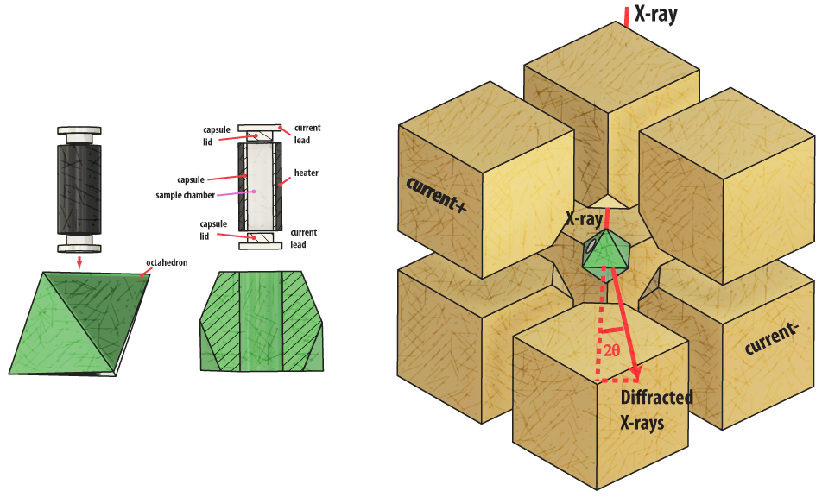
X-ray diffraction and HP environments
Environment is a complication
X-ray

Slide 23
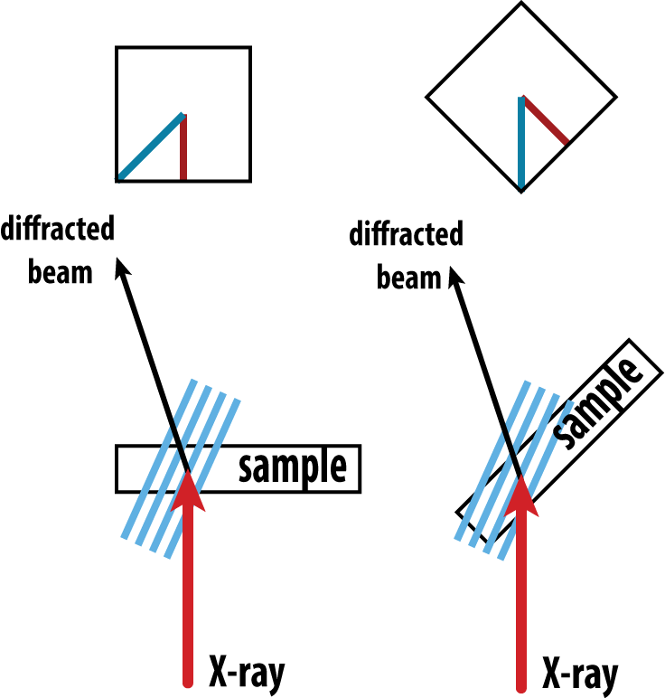
X-ray diffraction and HP environments
Absorption by environment
Absorption by sample

Slide 24
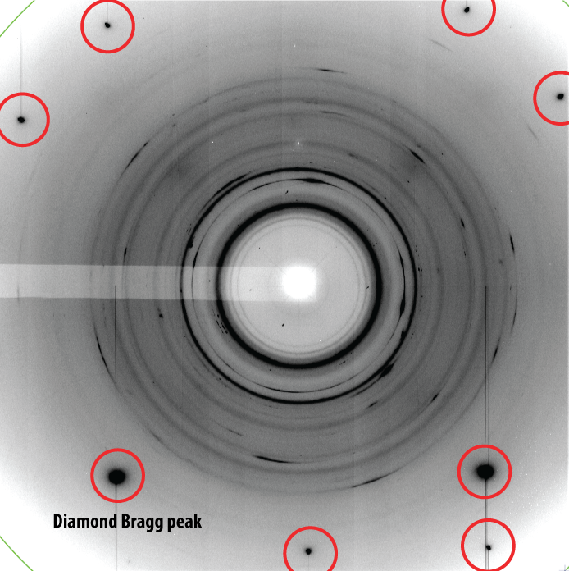
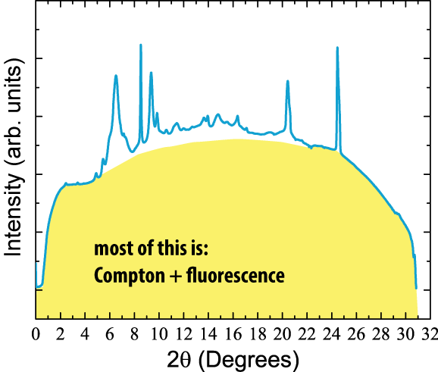
Examples: DAC
still image
Thick diamond reflects considerable amount of intensity.
This intensity can become a source for secondary diffraction (gasket). Bad for powder and amorphous material data.

Slide 25
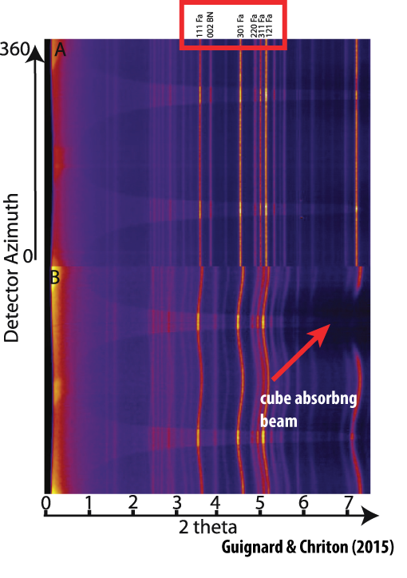
Examples: Multianvil
Signal from
the sample

Slide 26
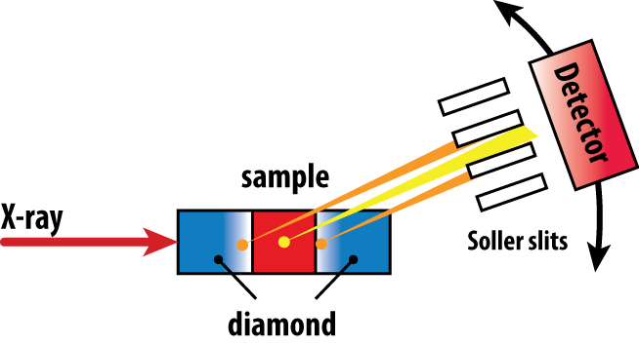
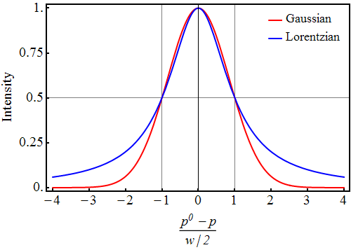
How to fight undesirable signal?
Soller slits: sacrifice signal,
improve signal/noise ratio
Smaller, less divergent beam:
higher signal/background
Gaussian form of the beam
reduce tails

Slide 27
Useful X-ray scattering signal

Slide 28
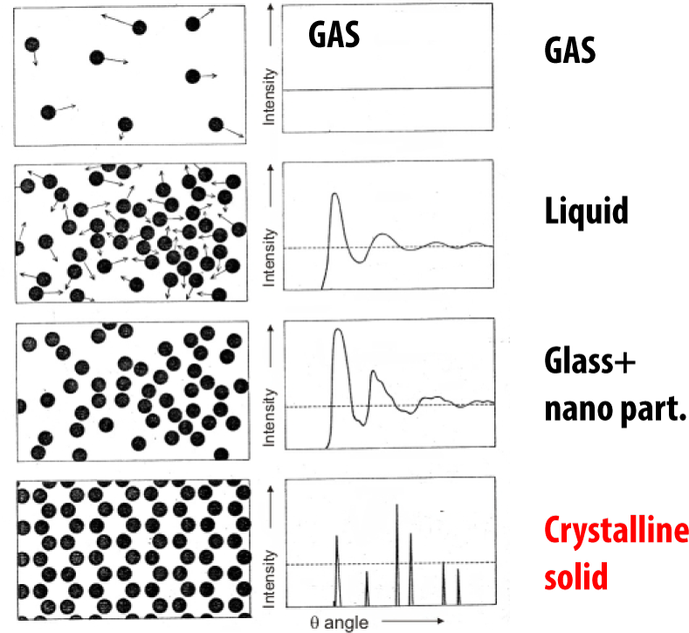

Slide 29
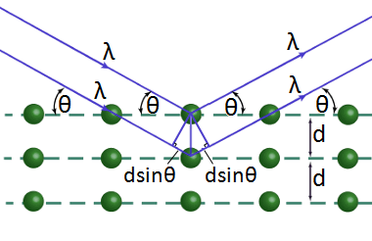
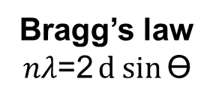
X-ray diffraction on crystalline solids
Real and reciprocal space
x,y,z – coordinates of atoms in the unit cell
hkl – indexing of lattice planes with
the specific d_{hkl} –spacing in the
reciprocal space
Bragg’s law
$$nλ\text{=2}d sin{\text{ϴ}}$$
hkl

Slide 30
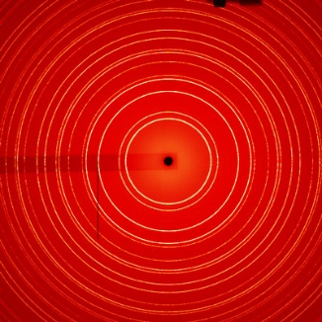
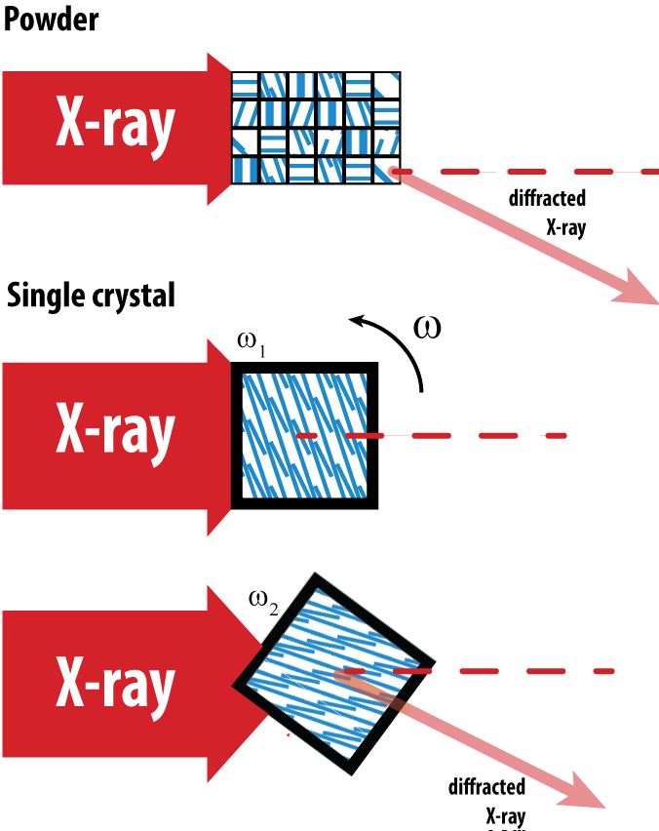
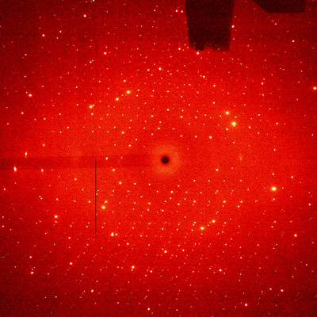
Powder vs Single crystal
Powder still image
Always some orientation for diffraction
Single crystal precession image
Want diffraction?
Rotate!!!

Slide 31
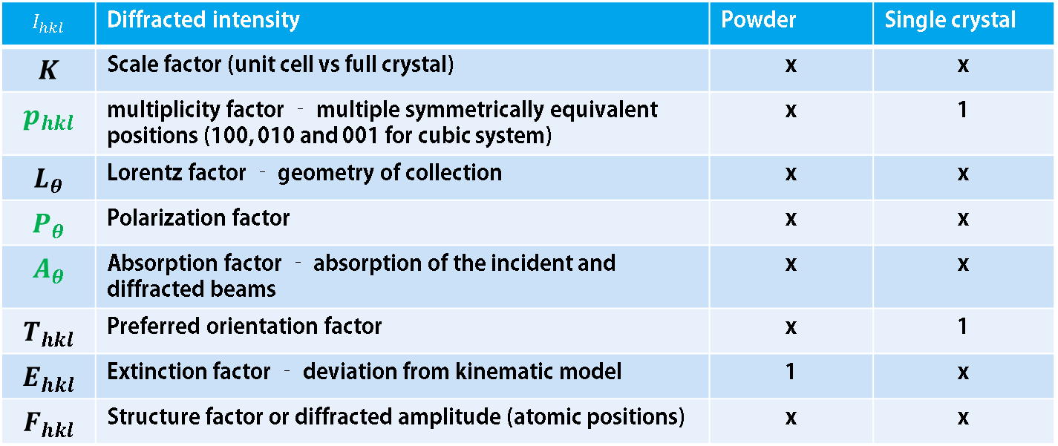
Intensity from X-ray diffraction on crystalline solids
after Pecharsky and Zavalij (2005)
Fundamentals of powder diffraction
$$I_{hkl}=K×p_{hkl}×L_{θ}×P_{θ}×A_{θ}×T_{hkl}×E_{hkl}×{\left|F_{hkl}\right|}^{2}$$
$$I_{hkl}$$ | Diffracted intensity | Powder | Single crystal
$$K$$ | Scale factor (unit cell vs full crystal) | x | x
$$p_{hkl}$$ | multiplicity factor – multiple symmetrically equivalent positions (100, 010 and 001 for cubic system) | x | 1
$$L_{θ}$$ | Lorentz factor – geometry of collection | x | x
$$P_{θ}$$ | Polarization factor | x | x
$$A_{θ}$$ | Absorption factor – absorption of the incident and diffracted beams | x | x
$$T_{hkl}$$ | Preferred orientation factor | x | 1
$$E_{hkl}$$ | Extinction factor – deviation from kinematic model | 1 | x
$$F_{hkl}$$ | Structure factor or diffracted amplitude (atomic positions) | x | x

Slide 32
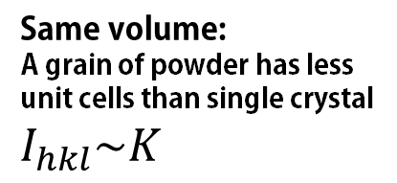
Scale factor: Powder vs Single crystal for High Pressure
Same volume:
A grain of powder has less unit cells than single crystal
$I_{hkl}\sim K$
Advantage powder:
Single shot – many hkls
Advantage single crystal:
Same material volume, single crystal scatters better – higher signal/noise ratio

Slide 33
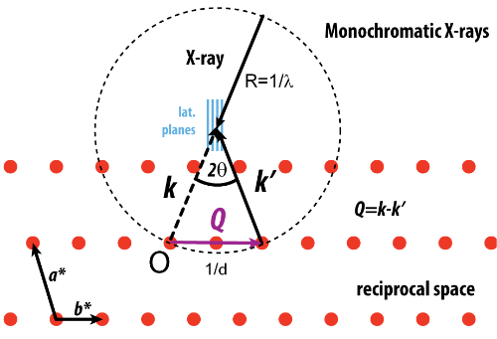
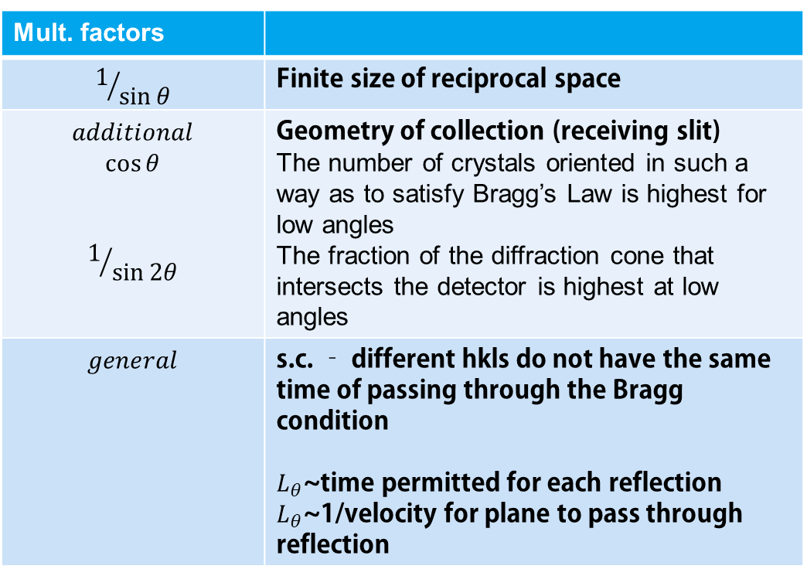
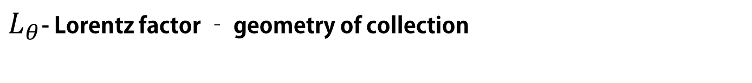
Intensity multipliers - Lorentz factor
after Pecharsky and Zavalij (2005)
Fundamentals of powder diffraction
$L_{θ}$- Lorentz factor – geometry of collection
Mult. factors
$$1/{\sin{θ}}$$ | Finite size of reciprocal space
$$additional$$ $$\cos{θ}$$ $$1/{\sin{2θ}}$$ | Geometry of collection (receiving slit) The number of crystals oriented in such a way as to satisfy Bragg’s Law is highest for low angles The fraction of the diffraction cone that intersects the detector is highest at low angles
$$general$$ | s.c. – different hkls do not have the same time of passing through the Bragg condition $L_{θ}$~time permitted for each reflection $L_{θ}$~1/velocity for plane to pass through reflection
hkl

Slide 34
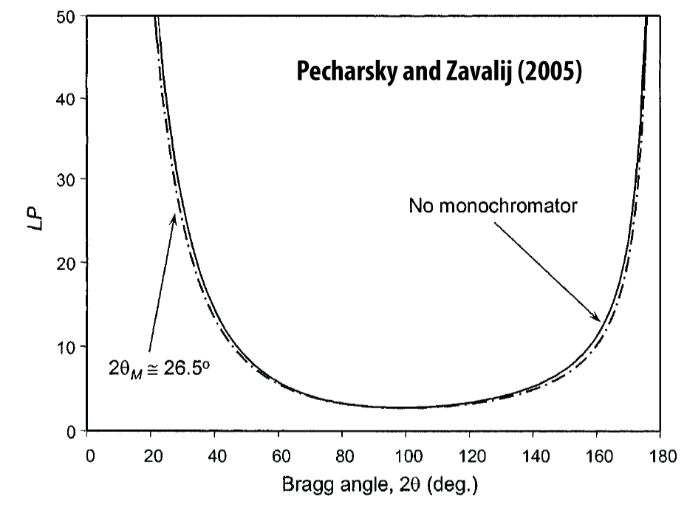
Intensity multipliers - Lorentz factor

Slide 35
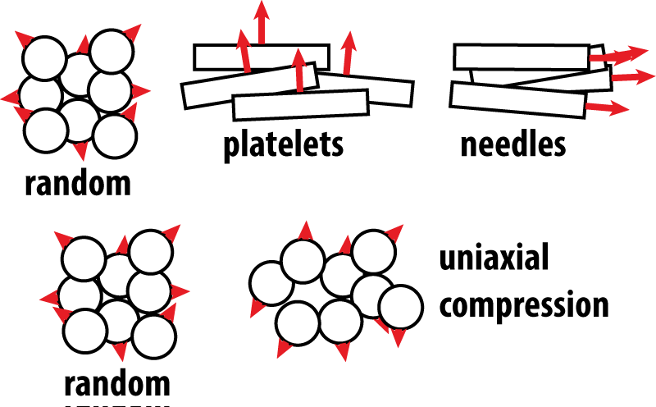
Preferred orientation $T_{hkl}$ ; only powders
Preferred orientation affects intensity relation of individual diffraction peaks – suppresses ones, increases the others

Slide 36
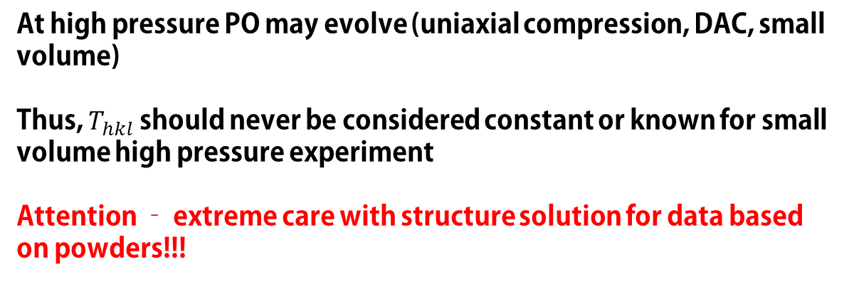
Preferred orientation $T_{hkl}$ ; only powders
starting material
pressurized material
At high pressure PO may evolve (uniaxial compression, DAC, small volume)
Thus, $T_{hkl}$ should never be considered constant or known for small volume high pressure experiment
Attention – extreme care with structure solution for data based on powders!!!

Slide 37
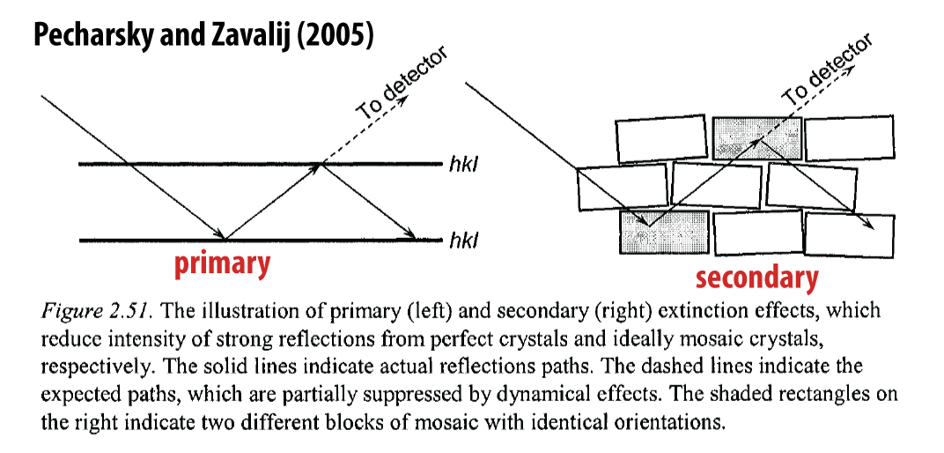

Extinction factor $E_{hkl}$ - mostly for single crystals
$$E_{hkl}=E_{B}(x)\sin^{2}{θ+}E_{L}(x)\cos^{2}{θ}$$
$x$ – function of shape, structure amplitude and number of unit cells per volume

Slide 38


Structure factor $F_{hkl}=F\left(h\right)$ - structure contribution
$$F_{hkl}=F\left(h\right)=\sum_{j=1}^{n}{g^{j}t^{j}(s)f^{j}(s)e^{2πi h∙x^{j}}}$$
$$F_{hkl}$$ | Structure factor
$$g^{j}$$ | Population, occupancy of an atomic position
$$t^{j}$$ | Temperature factor (Atomic Displacement Parameters - ADPs)
$$f^{j}$$ | Atomic scattering factor ($θ$, Z)
$$h∙x^{j}$$ | $\left(h,k,l\right)∙(x^{j},y^{j},z^{j})$ – scalar product of coordinates with HKL
$$s$$ | $${\sin{θ_{hkl}}}/λ$$

Slide 39


Thermal parameters: isotropic approximation
$$t^{j}=e^{−B^{j}\frac{\sin^{2}{θ}}{λ^{2}}}$$
$B^{j}=8π{\left({\overline{u}}^{2}\right)}^{j}$-isotropic displacement parameter for j_{th} atom
${\overline{u}}^{2}$- root mean square deviation of j_{th} atom from its (x_{j}, y_{j}, z_{j})

Slide 40



Thermal parameters
$$t^{j}=e^{−B^{j}\frac{\sin^{2}{θ}}{λ^{2}}}$$

Slide 41
Take away:
Important info for the signal
Scattering from electron to crystal lattice – how it works
Different types of signal: useful and not (emphasize on environment and background)
Diffraction as scattering: common and different features of single crystal and powder.
Diffracted intensity carries information: geometry, chemistry, structure
Be extremely careful with using powder for structure solution

